Slide 1

DIGITAL PORTFOLIO
NAME:JAYASHTIYA.S
REGISTER NO AND NMID : 24131211802522028
ASANM121ANM12124214029
COLLEGE: COLLEGE/ UNIVERSITY:
IMMACULATE COLLEGE FOR WOMEN /ANNAMALAI UNIVERSITY

Slide 2
WEB DEVELOPMENT FORM CREATION TABLE CREATION

Slide 3

AGENDA :
1.Problem Statement
2.Project Overview
3.End Users
4.Tools and Technologies
5.Portfolio design and Layout
6.Features and Functionality
7.Results and Screenshots
8.Conclusion
9.Github Link

Slide 4

PROBLEM STATEMENT: FOR FORM CREATION: Design and develop a web-based appilication form using HTML, CSS, and JavaScript that collects essential user information and provides real-time validation FOR TABLE CREATION: Design and develop a employee records table using HTML, CSS, and JavaScript that displays and organizes employee information in a clear and interactive manner

Slide 5
PROJECT OVERVIEW
• This project demonstrates the creation of a job appilication Portal using HTML, CSS, and JavaScript. It consists of two main
modules: a appilication form and a job appilicatin table. The appilication form collects user details such as name, email, phone, gender, course, and address
. Form fields are validated using JavaScript to ensure correct input (e.g., email format, phone number pattern, required fields).
The form is styled with CSS to provide a clean, user-friendly, and responsive design. The student appilication table displays employee information in a structured format with columns for Roll No, Name, Course, Marks, and Grade
. CSS is used to style the table with alternate row colors, hover effects, and responsiveness JavaScript adds interactivity by enabling column sorting and a search feature to filter records.
This makes it easy to organize, find, and manage student details. The project highlights frontend web development skills including layout design, styling, and client-side scripting

Slide 6
WHO ARE THE END USER
1. For Tech or Software Roles
• End users are the people who will ultimately use the software, app, or system you help build or support.
• Example: If you're applying for a front-end developer job, your end users might be customers interacting with a website or app.
2. For Customer Service or Support Roles
• The end users are typically clients or customers who need help with a product or service.
• Example: In an IT support job, the end user could be an employee needing help with their computer or software.
3. For Internal Company Roles
• End users might be colleagues or departments within the company who rely on your work.
• Example: A data analyst’s end users could be the marketing team using reports to make decisions.1

Slide 7
TOOLS AND TECHNIQUES;
🔹 TOOLS USED: HTML5– FOR CREATING THE STRUCTURE OF THE FORM AND TABLE. CSS3– FOR STYLING (COLORS, FONTS, BORDERS, HOVER EFFECTS, RESPONSIVENESS). JAVASCRIPT– FOR ADDING VALIDATION TO THE FORM, SORTING, AND SEARCHING IN THE TABLE. TEXT EDITOR / IDE– E.G., VISUAL STUDIO CODE, SUBLIME TEXT, OR NOTEPAD++. WEB BROWSER– E.G., GOOGLE CHROME / MOZILLA FIREFOX FOR TESTING AND EXECUTION. TECHNIQUES
🔹TECHNIQUES APPLIED:
1.Form Creation Techniques •Input fields (text, email, tel, date, radio, checkbox, file upload). •Validation using HTML attributes (required, pattern, minlength) and JavaScript. •CSS styling for user-friendly interface.
2.Table Creation Techniques •Table structure with

Slide 8
PORTFOLIO DESIGN AND LAOUT
Cover Page– Project Title, Your Name/Roll No, College/Dept, Year.
Problem Statement & Objectives– Why the project is needed and its goals.
Index– List of sections with page numbers. ➢Introduction– Brief on forms & tables in web development.
Tools & Techniques– HTML, CSS, JavaScript, Browser, Editor
. System Design– Layout diagrams/wireframes of form and table.
Implementation– Code snippets + screenshots of output.
Results– Successful form validation & interactive table.
Conclusion– Key learnings & outcomes.
Future Scope– Database integration, login, export features.
References– Books, websites, or tutorials used

Slide 9
FEATURES AND FUNCTIONALITY
FORM CREATION
•User-friendly form with labeled fields (Name,
Email, Phone, DOB, etc.).
•Validation using HTML5 and JavaScript
(required fields, email format, number limits).
TABLE CREATION
Structured data display using rows and
columns.
Styled layout with CSS (borders, alternating
row colors, hover effects).
Dynamic update (new entries can be added
from form into table).

Slide 10
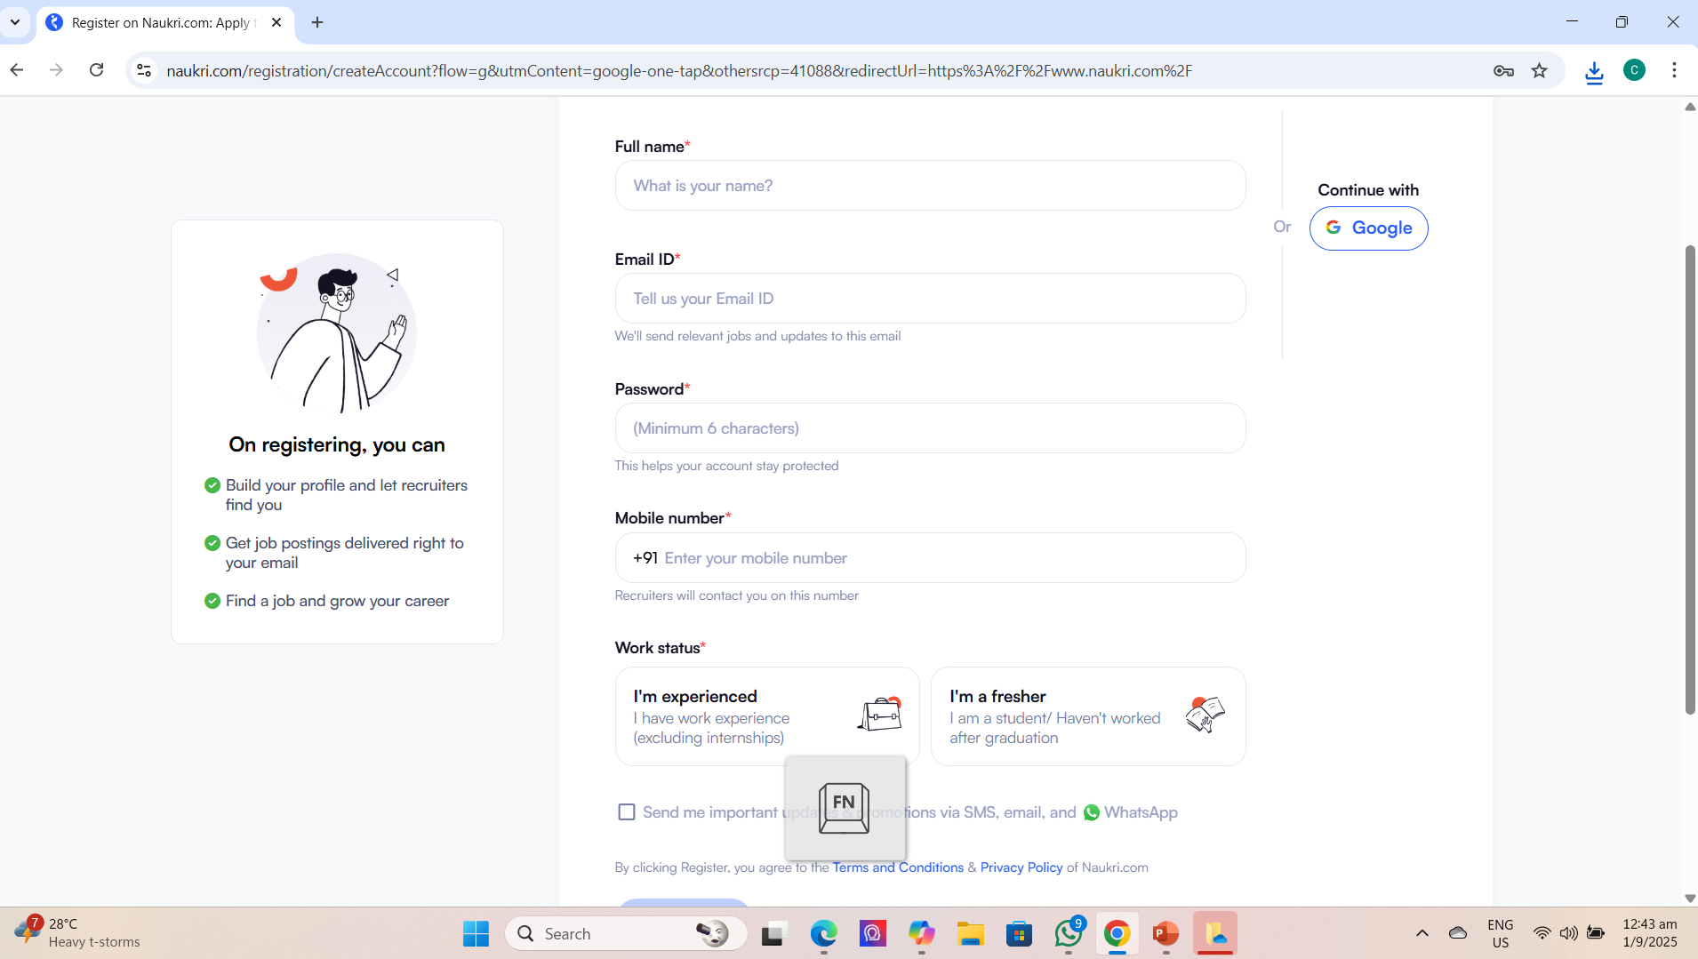
RESULT AND OUTPUT :

Slide 11
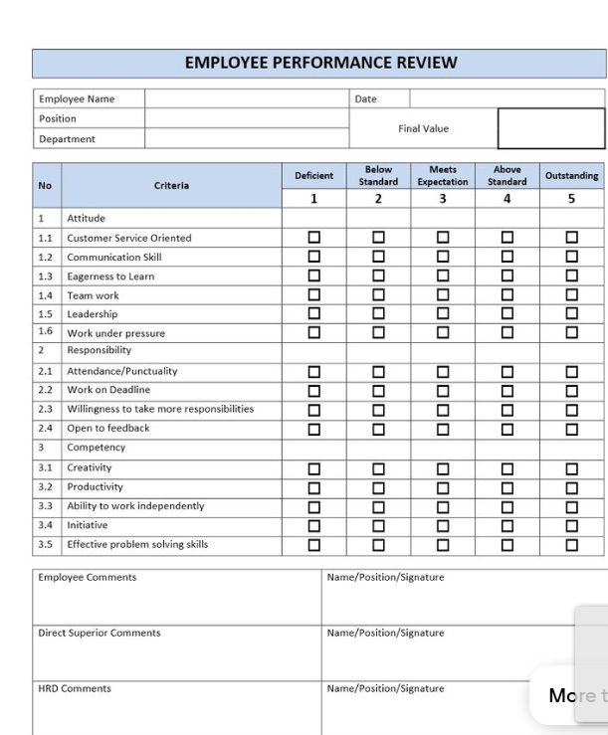
Result and output

Slide 12
Conclusion :
The integrity of any organization’s hiring and workforce management practices hinges on the thoughtful handling of job applications and employee records. A well-structured job application process not only ensures the selection of qualified candidates but also lays the foundation for transparent and equitable hiring decisions. Meanwhile, maintaining accurate and comprehensive employee records is essential for legal compliance, performance tracking, and operational efficiency.

